Slide 1
Modern Software Development and HTML

Slide 2
Languages involved From Source Code to Machine Code
Binary
“0’s and 1’s”, lowest level language, not actually written
Computers store data and compute in binary
Assembly
Language used by the CPU (central processing unit) to generate binary.
Simple instructions (move data, add values, etc) and a lot of them
Compiled Languages
Written in plain text, so need to be transformed into another form (assembly, machine code, etc) that can then be used by the computer or an intermediary program
Entire source file is compiled all at once
Interpreted / Scripting Languages
Source code is read, converted, and executed line by line
Useful for scripts or small programs
Markup Languages
purpose is to give context to or describe static content
Explains how content is meant to display or what content means
Not “programming” languages

Slide 3
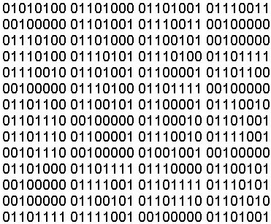
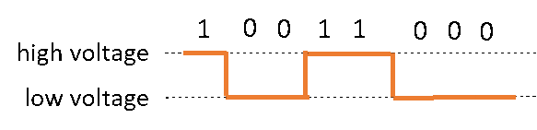
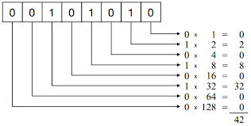
Binary – Examples

Slide 4
Binary Numeric System
1
3
6
7
8
0
Each non-zero digit represents a particular value
Add up those values and you get the total value
8 bits = 1 Byte
4 bits = nibble
0
0
9
0
5
2
10³
10²
10¹
10⁰
1
4
1000
100
10
1
1
0
0
0
1
1
2⁷
2⁶
2⁵
2⁴
2³
2²
2¹
2⁰
128
64
32
16
8
4
2
1
256 total values
0 - 255

Slide 5
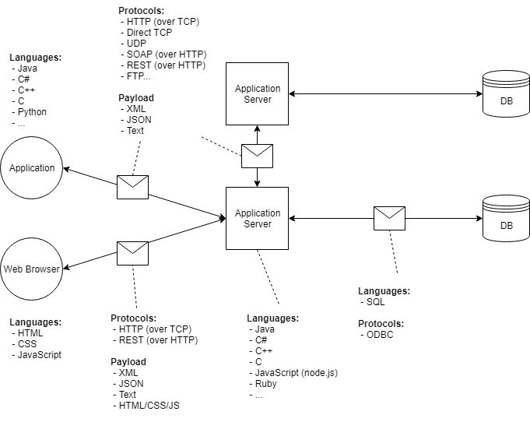
Client-Server-Database Architecture

Slide 6
What’s Missing?
Frameworks! Libraries!
Library: utilities written by someone else to perform complex work with a simple(r) API.
JDBC Drivers: Java libraries to facilitate sending SQL queries from a Java application to a database, and translating the results into Java code
JQuery: JavaScript library for simplifying many common JavaScript tasks
Framework: Larger utilities designed to run your code for you (i.e. you write code specifically to be used by the framework) to make certain tasks easier.
Spring: Java framework for building applications that are extremely easy to expand and test.

Slide 7
Markup Languages and Web Browsers
Web browsers render (draw) HTML documents into static content
Writing HTML is like using a word document.
Purpose is to structure and display content
HTML is not “streamed” from a server, the entire file is downloaded
HTML is markup that gives meaning and structure to a plain text file.
CSS can be used to change how the browser displays HTML content
JavaScript can be used to cause the browser to perform additional tasks, and modify the HTML or CSS used to render a file.
Allows for dynamic content

Slide 8
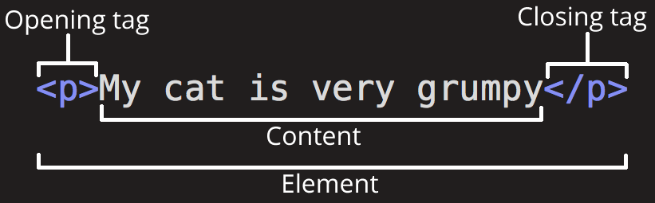
HTML Element

Slide 9
Mandatory Elements
Every HTML page must have these 5 elements to be “valid”:
<!DOCTYPE>
<html>
<head>
<title>
<body>
Technically, these were only required in HTML4. HTML5 allows <html>, <head>, and <body> to be omitted under certain conditions, but this can break some tools and introduces ambiguity.
Most interviewers aren’t going to know this when they ask you about “mandatory HTML elements”.

Slide 10
Inline and Block elements
Vs code manipulates the files in your file system
Inline elements can be positioned next to each other horizontally
<a>, <span>, <strong>, <em>, etc.
Block elements create a “block” the width of the entire page (they “block” elements from sitting to the left or right of them)
<p>, <div>, <ol>, etc. <br />
Basic elements and then inline vs block

Slide 11
HTML Resources
HTML is one of the simplest languages to learn and test.
You can write HTML code in any text editor
You can run HTML code in any web browser
https://www.w3schools.com/html/
https://developer.mozilla.org/en-US/docs/Web/HTML
https://techterms.com/

Slide 12
Common HTML Attributes
Attributes add “metadata” to an element. They describe what the element is doing.
Some attributes are usable by every HTML element
id=“value”: used to give a unique ID to a single element
class=“value” : used to group elements for styling or scripting purposes. Can have multiple values separated by spaces
style=“key:value;” : used to set styling directly on an element. Can have multiple key:value pairs, separated by semicolons (;)
A tag, # href

